Slide 1
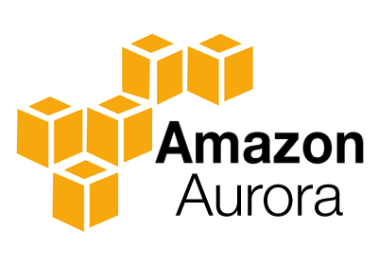

Slide 2

Topics
What is Aurora?
Basic of Aurora
Aurora Replicas
Backups with Aurora
Amazon Aurora Serverless
Exam tips

Slide 3

What is Aurora?
Amazon Aurora is a MySQL and PostgreSQL compatible relational database engine that combines the speed and availability of high-end commercial databases with the simplicity and cost-effectiveness of open-source databases.
Amazon Aurora provides up to five times better performance than MySQL and three times better than PostgreSQL databases at a much lower price point, while delivering similar performance and availability.
Amazon RDS manages your Amazon Aurora databases, handling time-consuming tasks such as provisioning, patching, backup, recovery, failure detection and repair. You pay a simple monthly charge for each Amazon Aurora database instance you use.

Slide 4
The basics of Aurora
Start with 10GB, Scales in 10GB increments up to 64TB (Storage Auto Scaling)
Compute resources can scale up to 32vCPUs and 244GB of Memory
2 copies of your data is contained in each availability zone, with minimum of 3 availability zones. 6 copies of your data.
Scaling Aurora:
Aurora is designed to transparently handle the loss of up to two copies of data without affecting database write availability and up to three copies without affecting read availability
Aurora Storage is also self-healing. Data blocks and disks are continuously scanned of error and repaired automatically

Slide 5
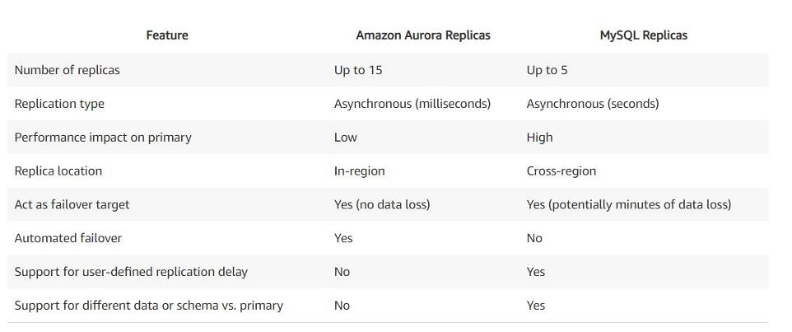
3 Type of Aurora Replicas
Aurora Replicas (currently 15)
MySQL Read Replicas (currently 5)
PostgreSQL (currently 1)

Slide 6

Backup and Restore in Aurora
Automated backups are always enabled on Amazon Aurora DB Instances.
Backups do not impact databases performance
You can also take snapshot with Aurora. This also does not impact on performance
You can share Aurora Snapshots with other AWS accounts
Amazon Aurora automatically maintains 6 copies of your data across 3 Availability Zones and will automatically attempt to recover your database in a healthy AZ with no data loss.

Slide 7
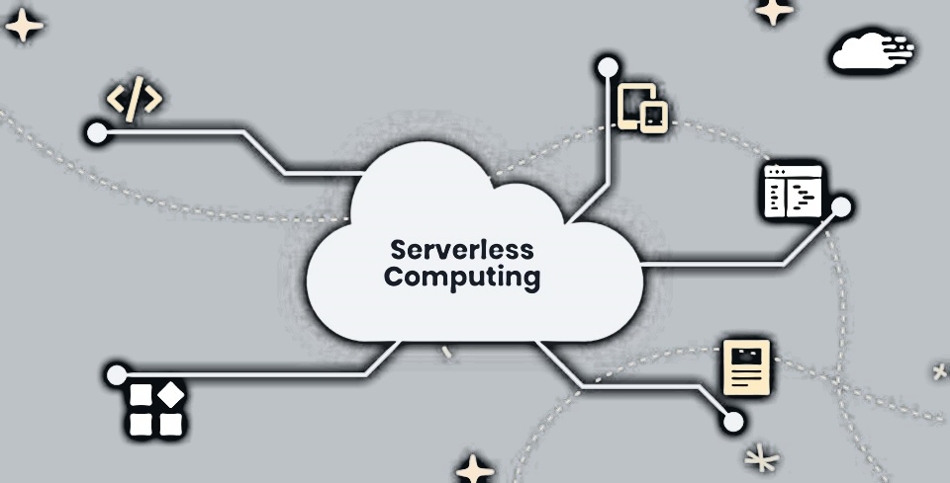
Amazon Aurora Serverless
Amazon Aurora Serverless is an on-demand, autoscaling configuration for the MySQL compatible and PostgreSQL compatible editions of Amazon Aurora.
An Aurora Serverless Db Cluster automatically starts up, shuts down and scales capacity up or down based on your application's needs.
Aurora Serverless provides a relatively simple, cost-effective option for infrequent, intermittent or unpredictable workloads

Slide 8

Exam Tips:
2 Copies of your data are contained in each availability zone, with minimum of 3 availability z. 6 copies of your data.
You can share Aurora Snapshots with other AWS accounts.
3 types of replicas available. Aurora Replicas, MySQL replicas & PostgreSQL replicas.
Automated failover is only available with Aurora Replicas
Aurora has automated backups turned on by default. You can also take snapshots with Aurora.
Use Aurora Serverless if you want a simple, cost-effective option for infrequent, intermittent or unpredictable workloads.

Slide 9
Thank you

